Slide 1

Coffee Shop Sales Analysis

Slide 2
Report
Project Objective: Analyze historical sales data to identify trends, patterns, and opportunities for improvement. Create a comprehensive dashboard to visualize key insights
Dashboard Creation: Layout and Formatting: Design a visually appealing dashboard using Excel's formatting options.
Key Metrics: Display key performance indicators (KPIs) and measures prominently.
Interactive Elements: Use slicers to filter data dynamically, data can be modified for identifying the patterns and trends.
Clear and Concise Visualizations: Choose appropriate chart types and formatting to convey information effectively
Data Source: A CSV file containing coffee shop sales data, sourced from Kaggle.
Data Import: Import the CSV file into Excel
Data Cleaning: Handling the missing values (e.g., delete rows, fill with averages), Formatting the dates and currencies also removed duplicates
Data Analysis and Visualization: PivotTables are created calculated key metrics like total sales, average order value, and customer frequency. Line charts, Bar charts, Pie charts have been used

Slide 3
Recommendations and Findings
1. How do sales vary by day of the week and hour of the day?
On day to day basis, the sales are comparatively higher on the weekdays than the weekends.
It is to be noted that the sales are highest on Monday’s. Further, peak hours of each day can be considered as 7am to 10am.
Customer’s behavior can be Identified and the buying patterns can be analyzed and be improved.
Cost can be saved by optimizing the inventory levels and negotiations with the suppliers can be done, in order to ensure there are cost efficient purchases.

Slide 4
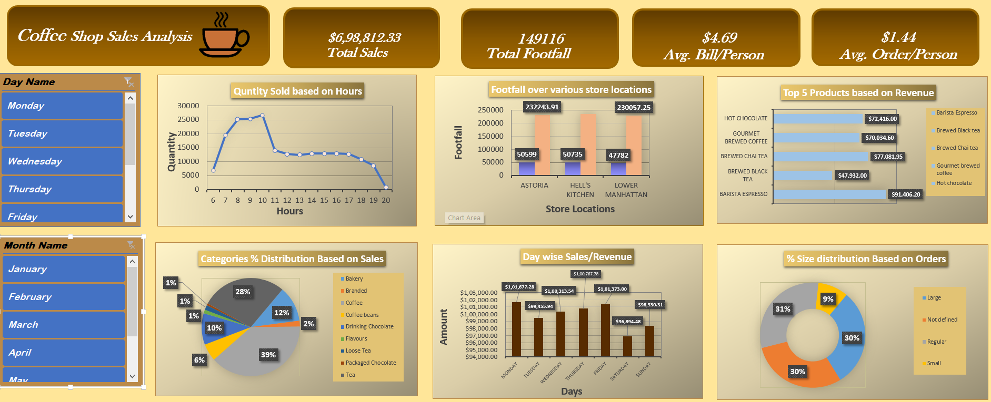
Recommendations and Findings
3. What is the total sales revenue for each month?
Total sales revenue for each month can be identified by using the slicer available and selecting the months accordingly.

Slide 5

Recommendations and Findings
3. Describe the footfall across different store locations?
The Footfall and earnings are highest in the Hell’s Kitchen.
using the slicer.
The data can be modified by the user in order to find out the monthly and day wise information.
Total footfall can also be found out using the same.
By analyzing this the stores can be arranged on the basis of highest earner to least earners which will help in the deciding the management, employee training and other information.

Slide 6
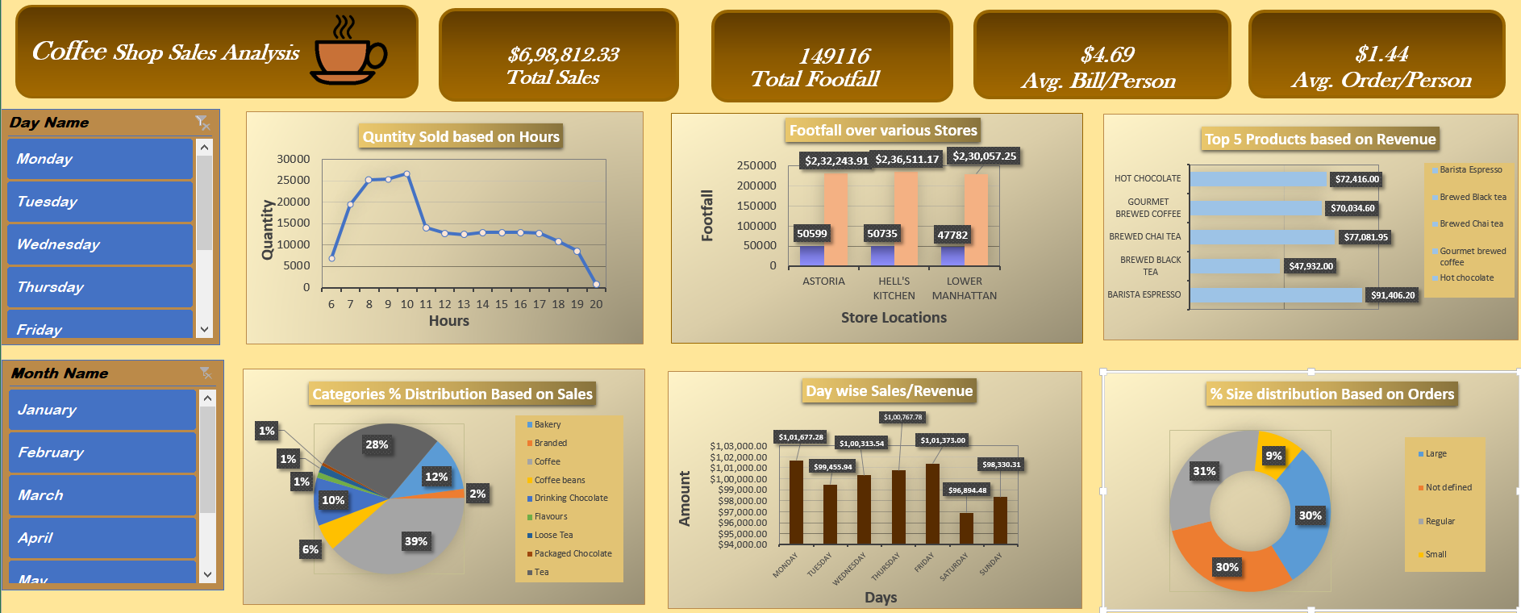
Recommendations and Findings
5. What is the average price/order per person?
This analysis can be used to Optimize operations in the stores.
Staffing adjustments, Promotion of the products, Efficient
Inventory management, Customer feedback can be done
proficiently which will help the stores to gain profits and
goodwill in the market.

Slide 7
Recommendations and Findings
6. Which products are the best selling in terms of quantity and revenue?
This analysis can be useful for the store managers to make sure
that their products demand.
Effective employee training can be provided.
Good quality management can lead to customer satisfaction and
loyalty.
Further, (USP) Unique selling points can be analyzed
and help gain competitive advantage in the market.

Slide 8
Recommendations and Findings
7. How do sales vary by product category and type?
This part of the analysis shows that the categories of product
demanded have a positive correlation with the sales.
The percentage wise distribution can be seen in the pie chart
which will help in deciding the focus of production of the categories
according to it’s demand.
Resources can be utilized efficiently with this analysis and customer
loyalty can be increased.

Slide 9

Thank you
-Harshal Bankar

